Slide 1
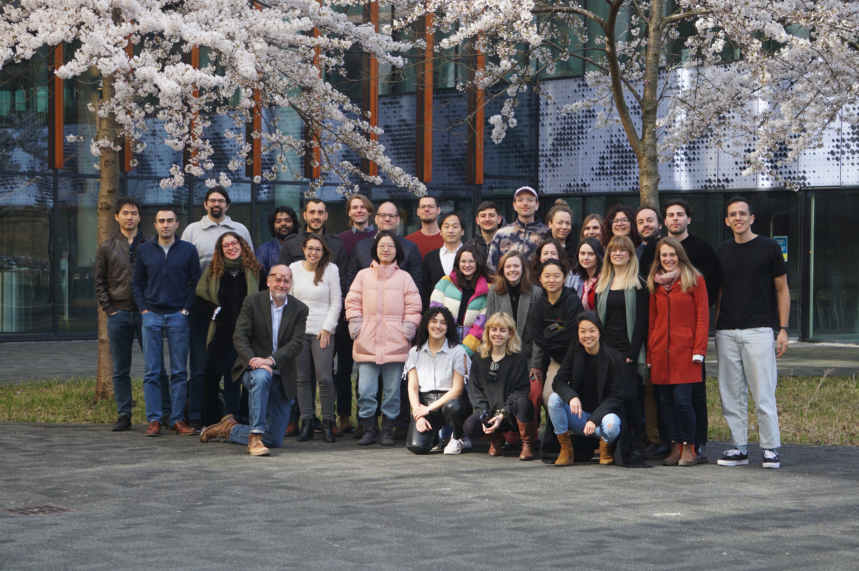



Emergence of oscillations in a biologically realistic model of a V1 cortical column
Giulia Moreni¹, Cyriel Pennartz¹, Jorge Mejias¹
¹Cognitive and System Neuroscience group, SILS, University of Amsterdam

Slide 2
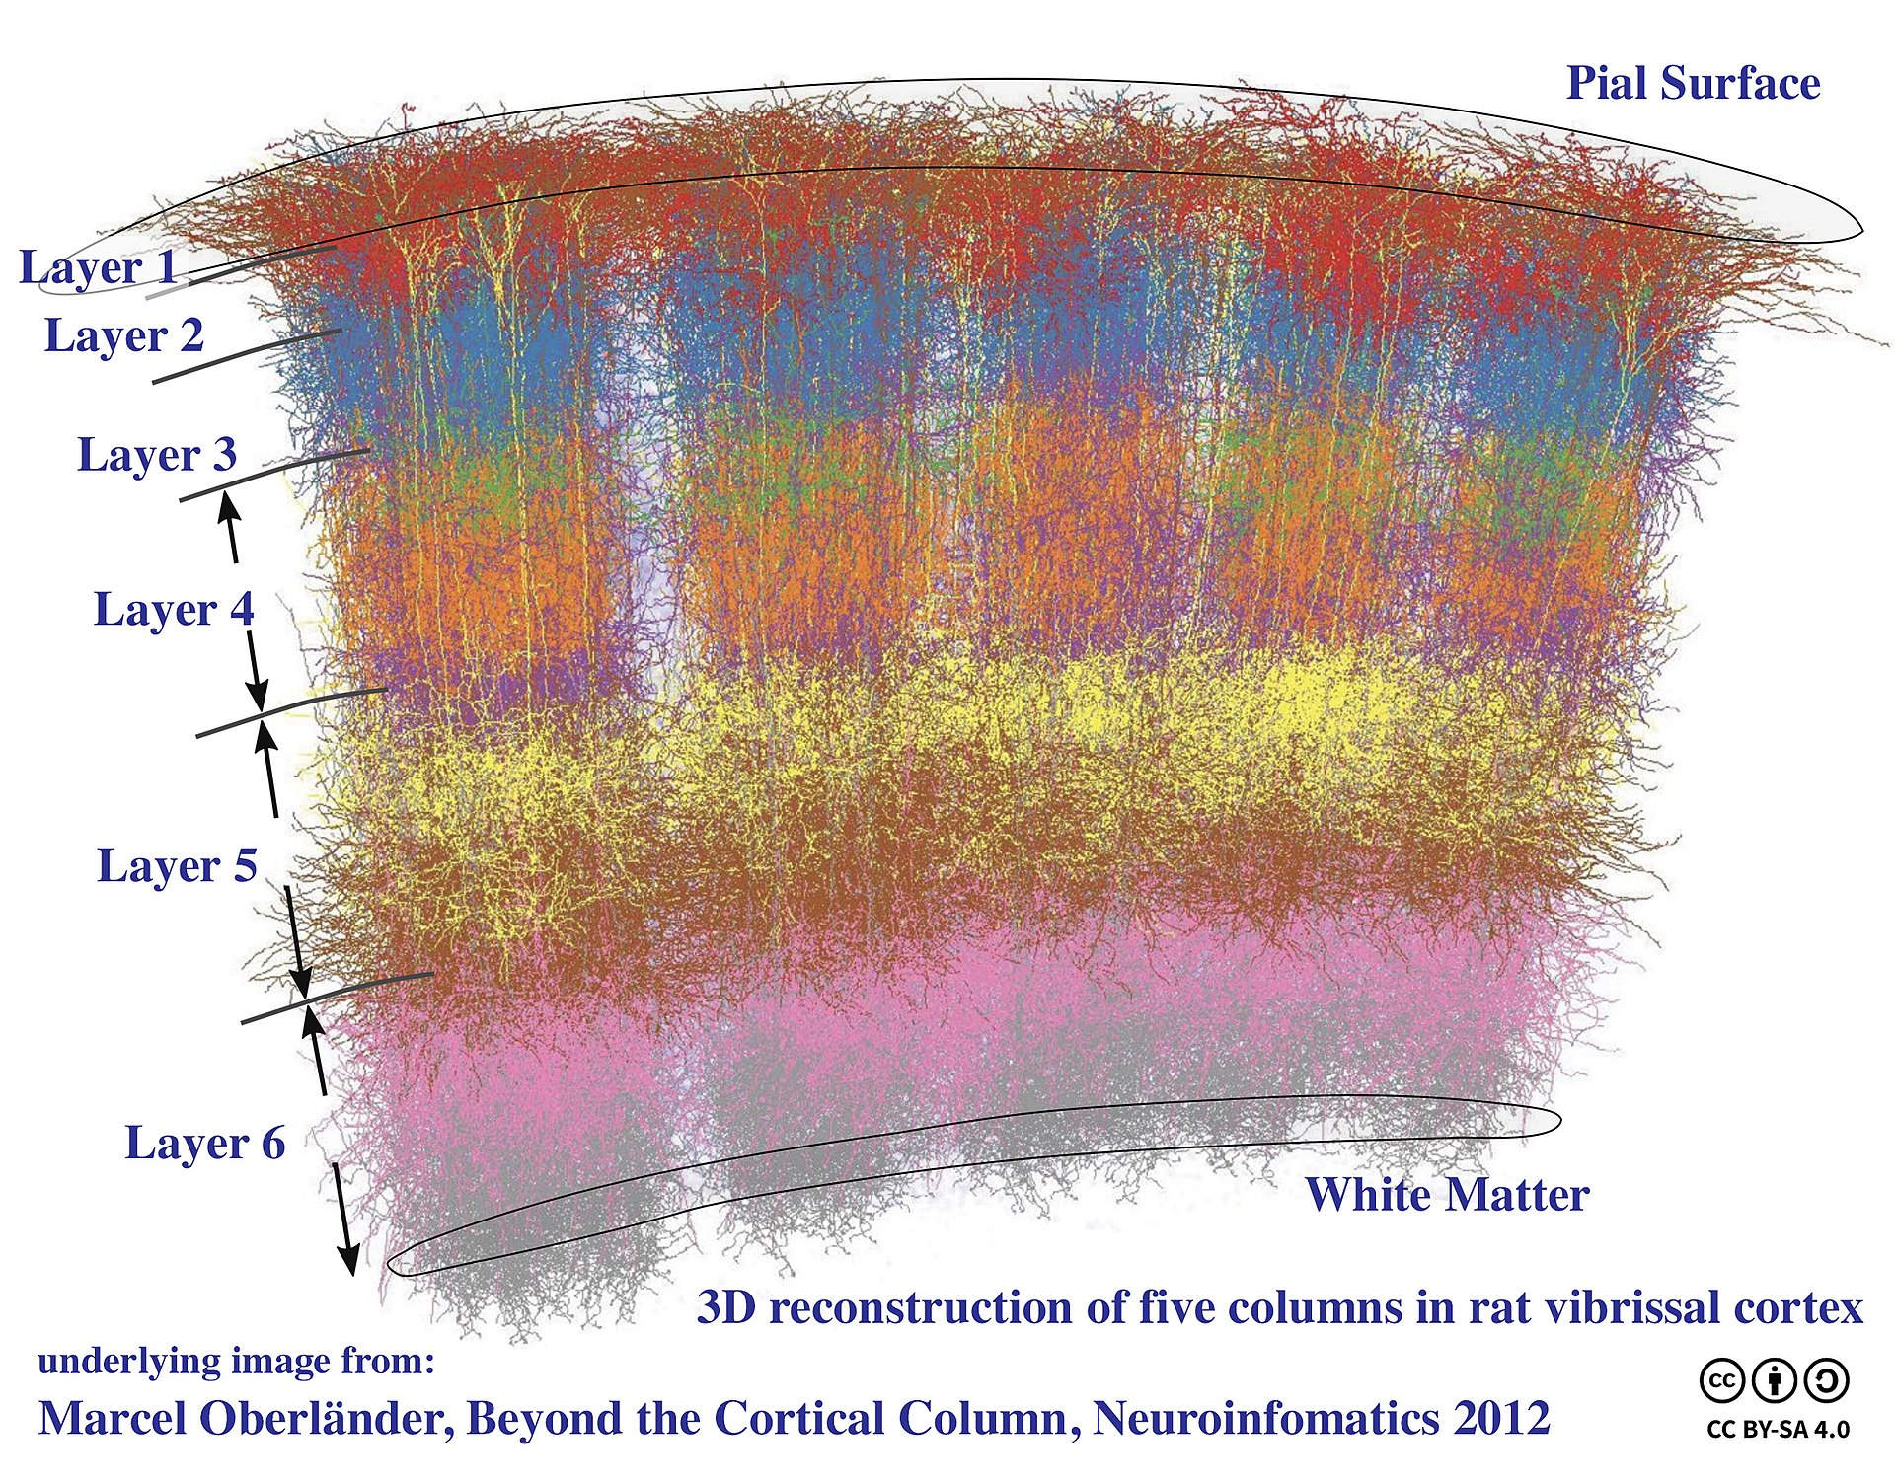
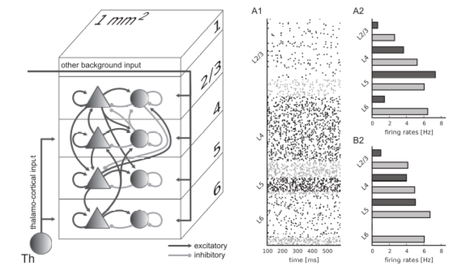
General Intro
Cortical column: building block of brain function
We added:
Interneurons types
Receptors
Plasticity
Why?
Connections with experiments (optogenetics)
Biologically plausible
Potjans, T. C. & Diesmann, M.
The cell-type specific cortical microcircuit: relating structure and activity in a full-scale spiking network model. Cereb. Cortex 2014
Research questions:
1) Role of feedforward and feedback in the cortical column
2) Plasticity and Oscillations, role of inhibitory neurons
3) Orientation selectivity in the column
4) LFP simulation in a cortical column model

Slide 3
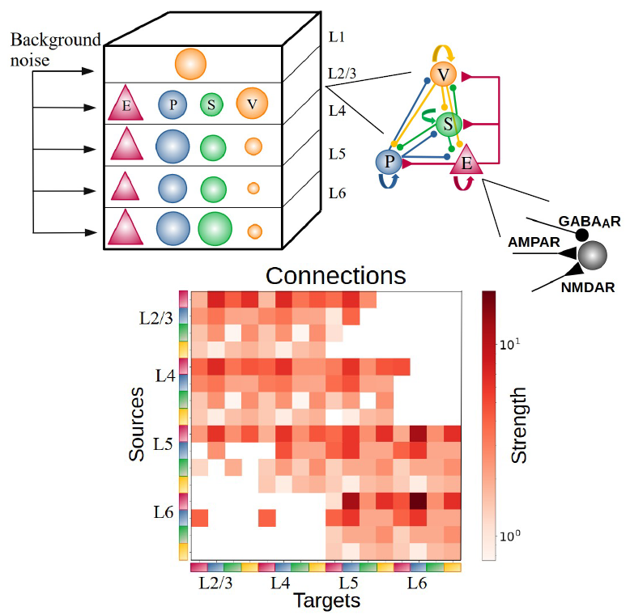
General overview of the model – Spiking cortical column
Simulate a large-scale network of spiking columnar circuits in V1 with biologically realistic features.
Model of cortical column with:
- 5 distinct cortical layers
- Multiple interneuron types (PV, SST, VIP cells)
- Includes dynamics of different postsynaptic receptors (AMPA, GABA, NMDA) with exact equations.
Realistic biological constraints (Allen Institute):
- 85% Excitatory, 15% Inhibitory cells in each layer
- Percentage of each type of cell for each layer
- Matrices of connectivity probability and synaptic strength

Slide 4
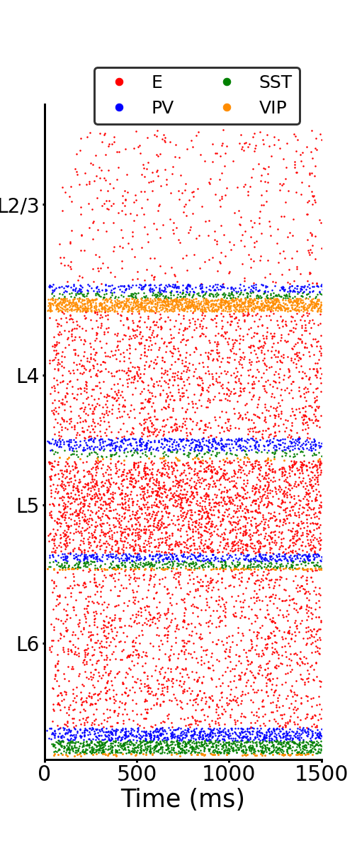
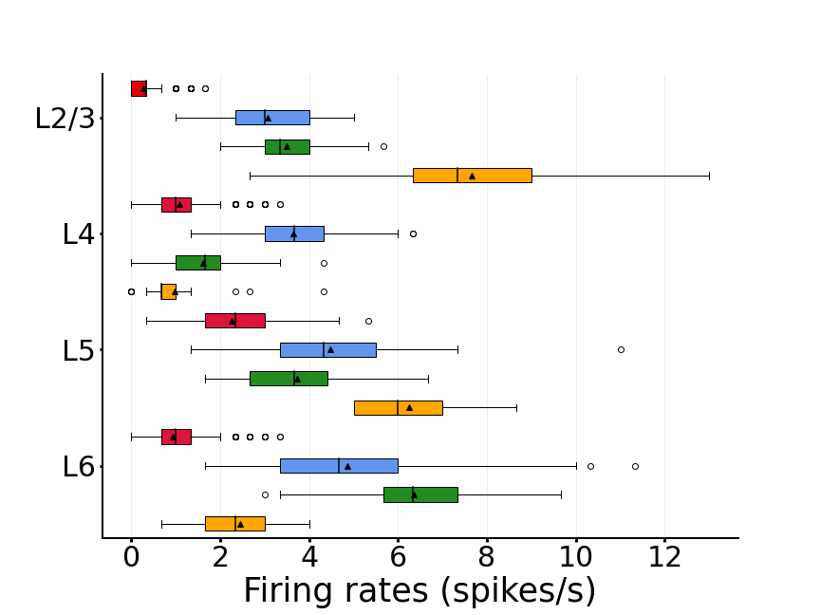
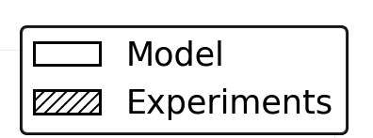
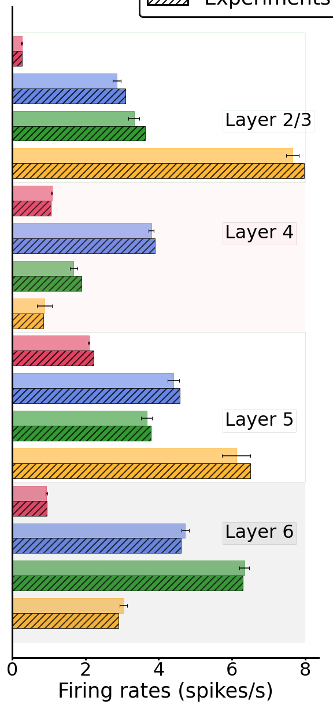
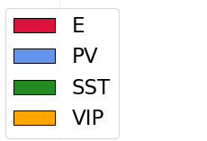
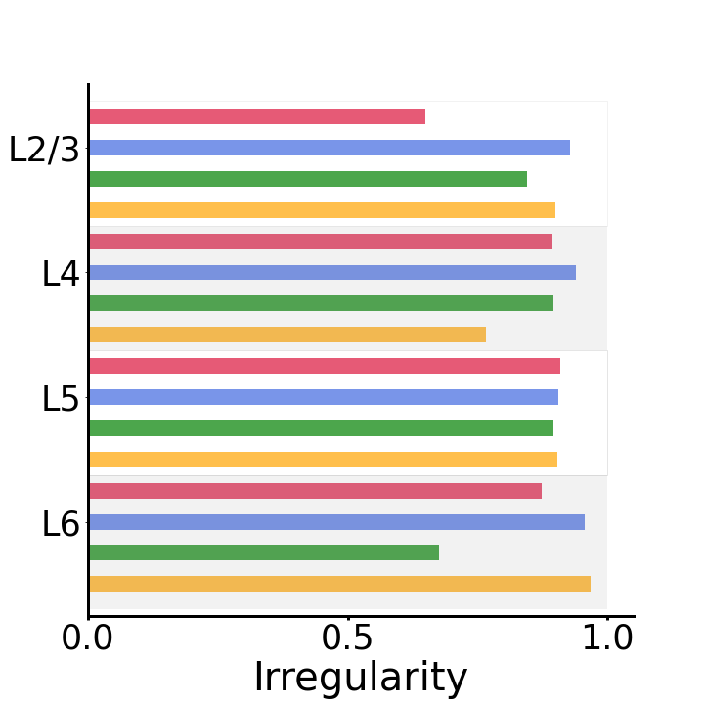
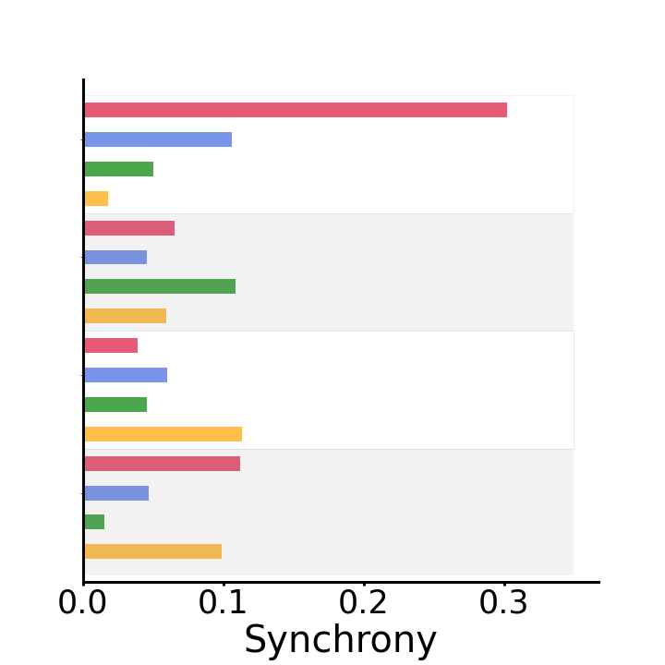
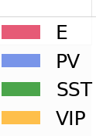
Spontaneous condition matching experimental data
Layer and cell-specific spontaneous activity matching experimental data.
A
B
C
neuron index
D
Fig. 2

Slide 5
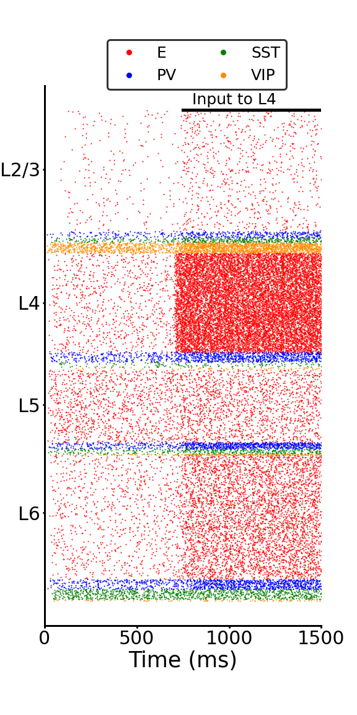
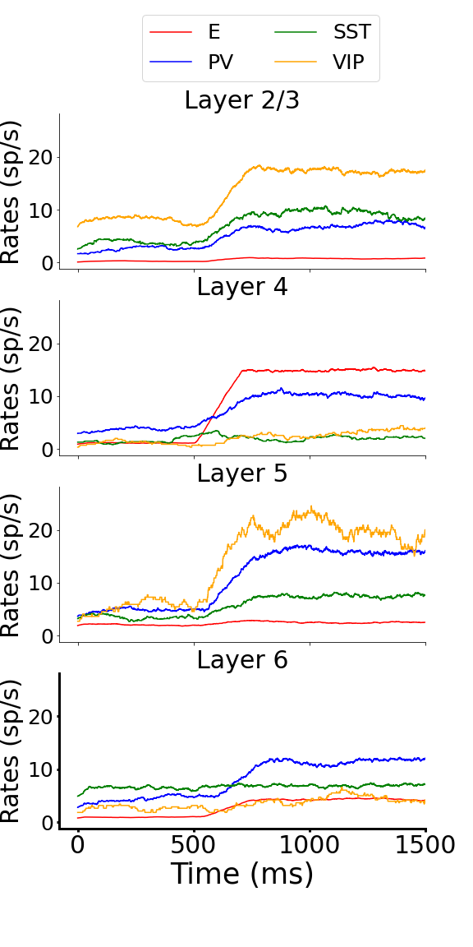
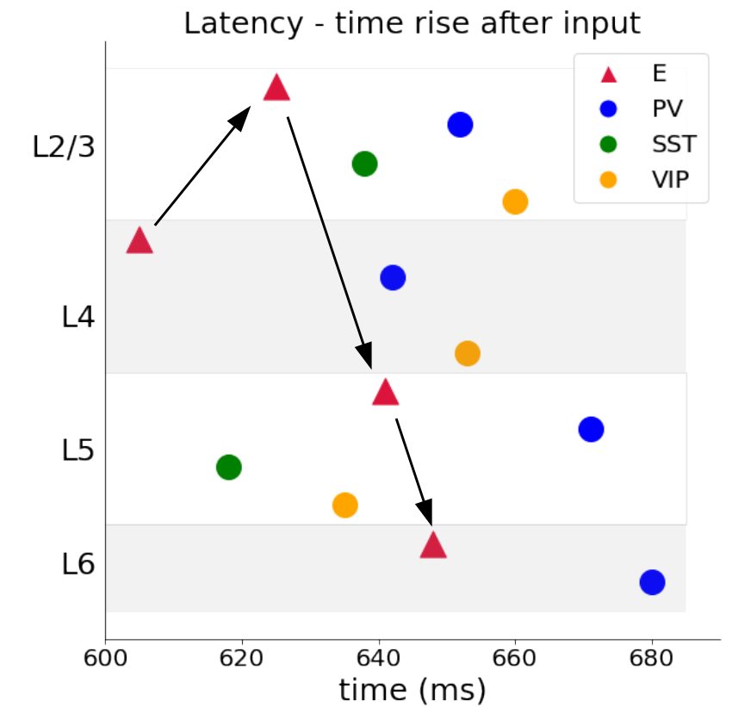
How the system behave with an input to E4 (FF input)?
Layer and cell-specific spontaneous activity matching experimental data.
Layer and cell-specific evoked (FF input) activity matching experimental data.
A
B
C
D
Notes:
5

Slide 6
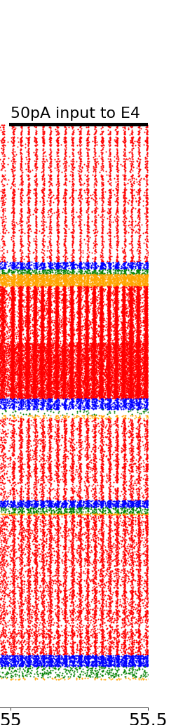
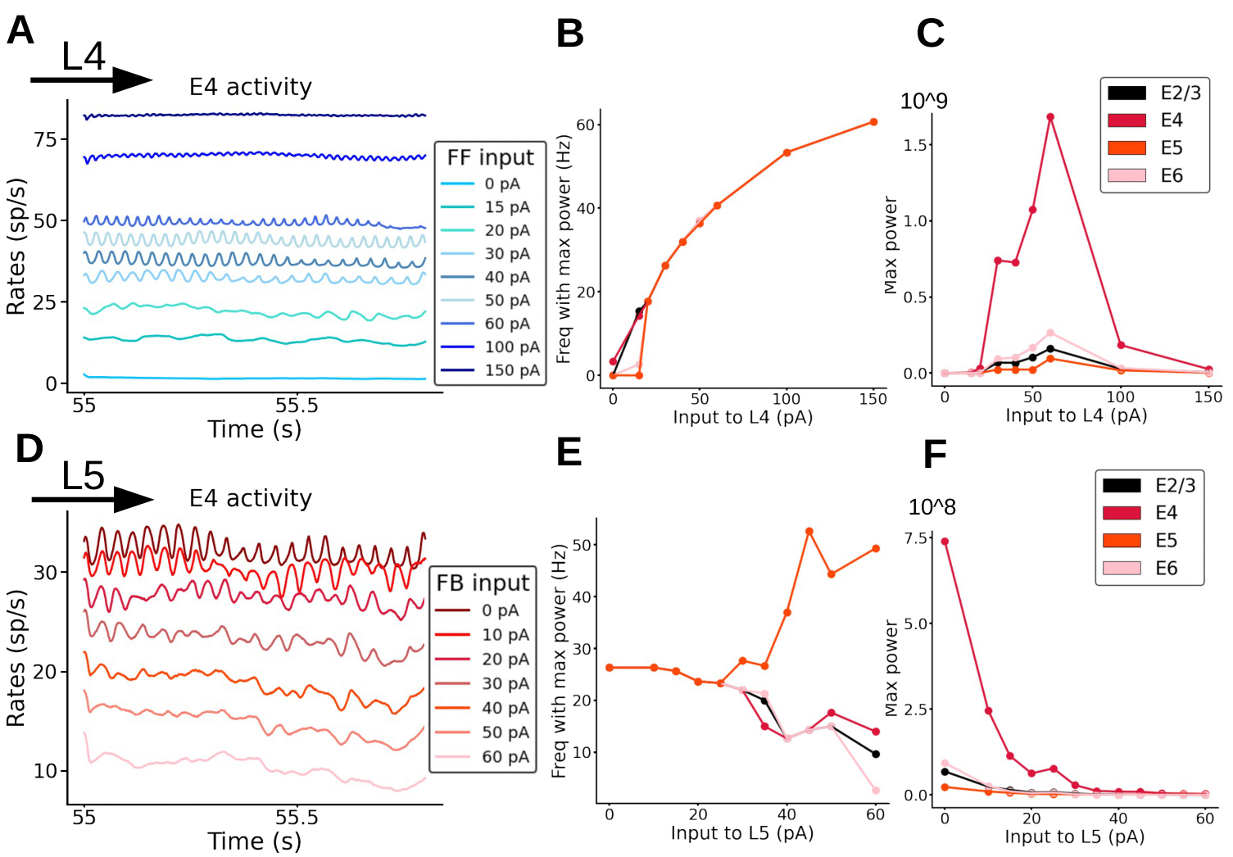
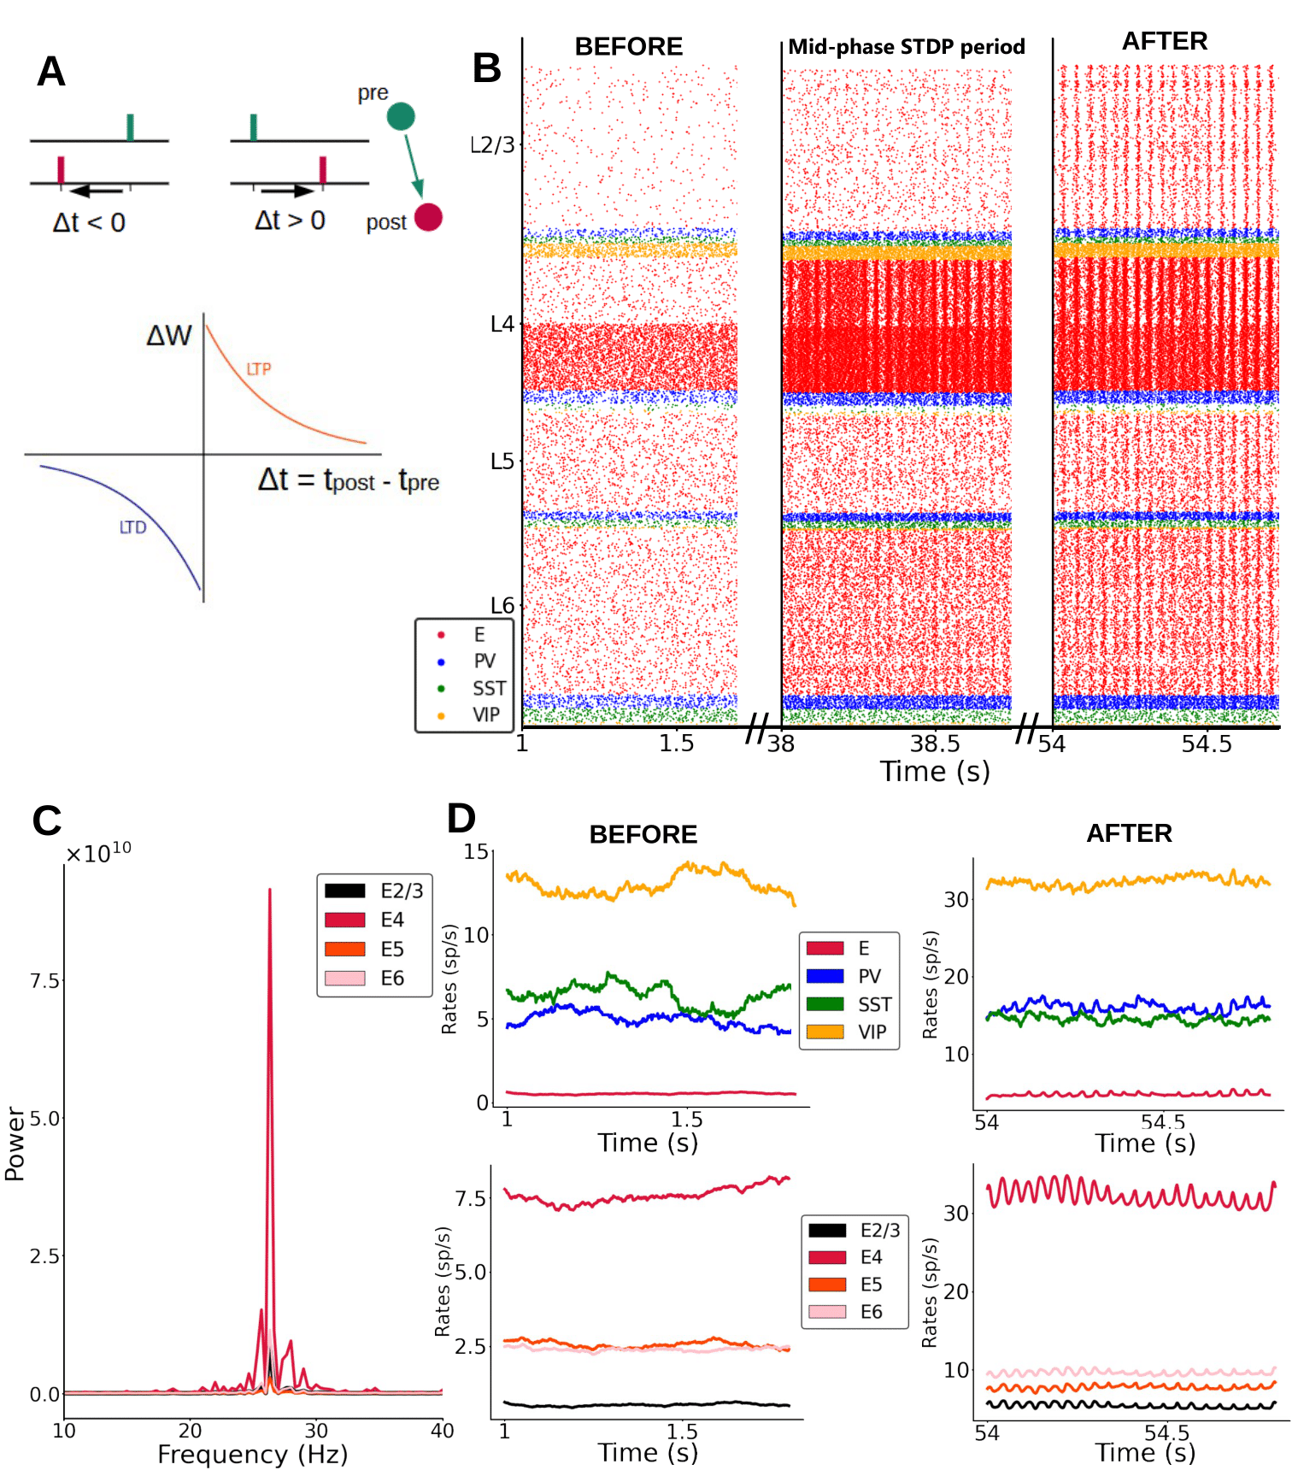
Plasticity in the model - STDP
Frequency depends on the input, f in [12 Hz – 60 Hz]
FB switches off oscillations

Slide 7
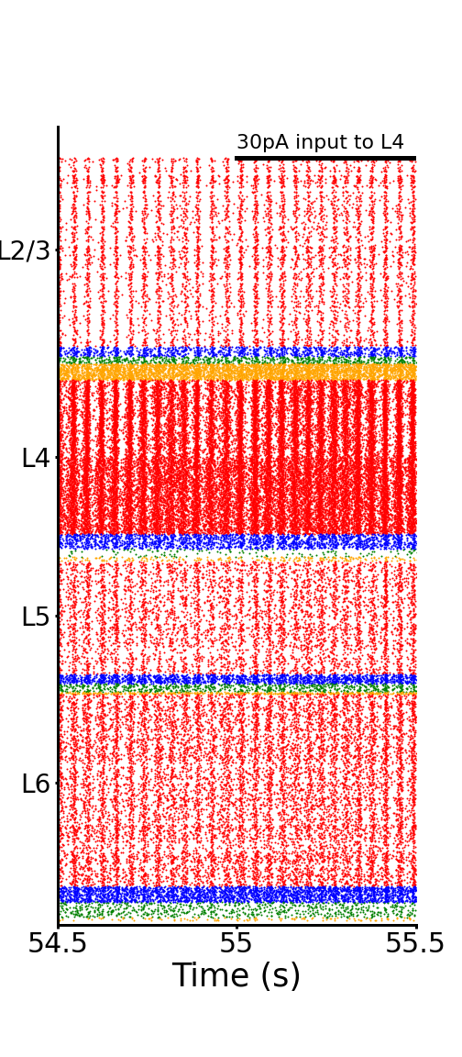
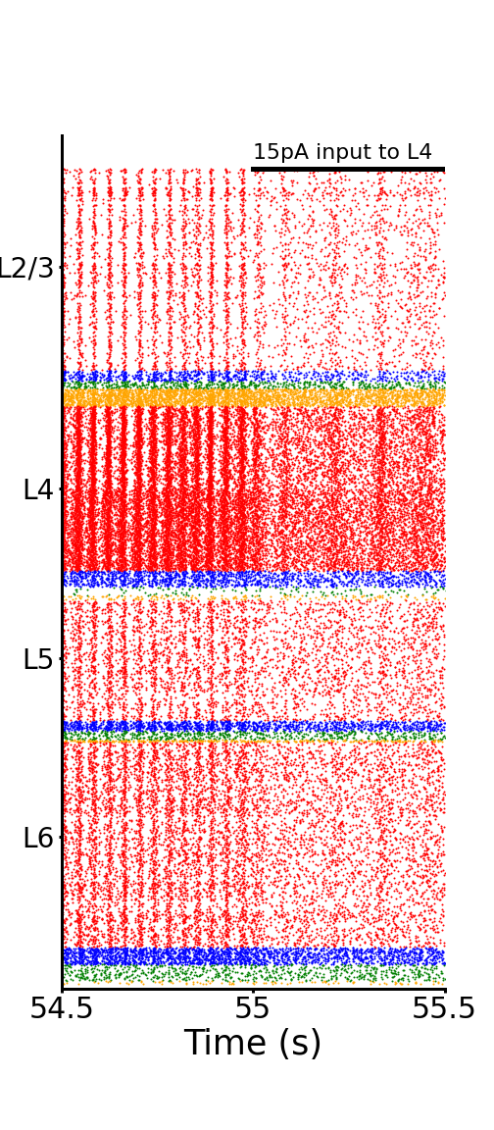
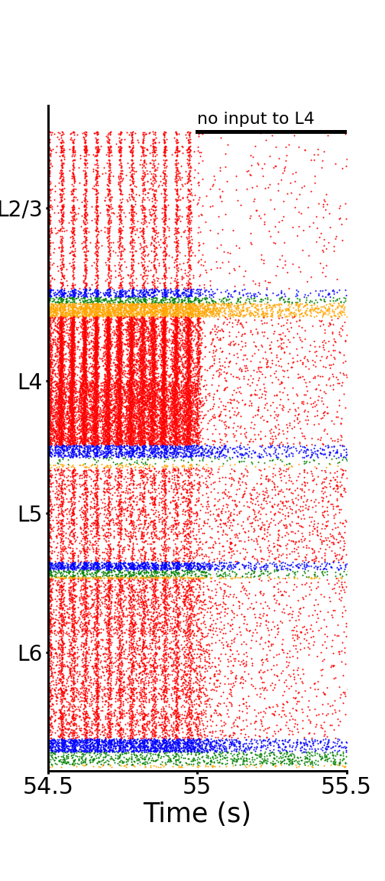
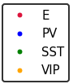
Effect of the FF input on oscillations (after learning)
From 55s the weights are fixed again.
I give different input to E4 and
see the effect on the frequency.

Slide 8
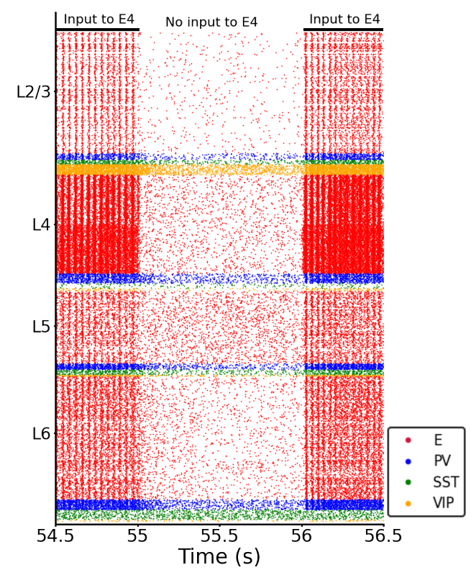
Effect of the FF input on oscillations
At 55 input off → no oscillations
Then I switch on the input again → oscillations are back
Notes:
8

Slide 9
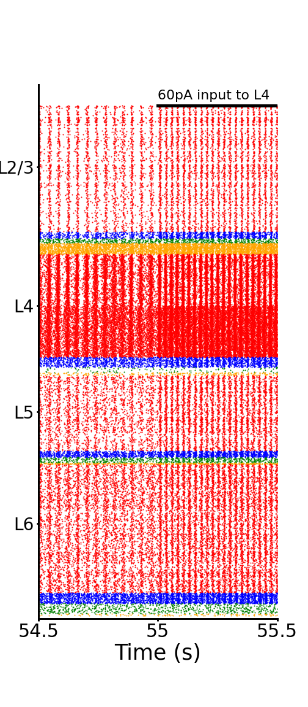
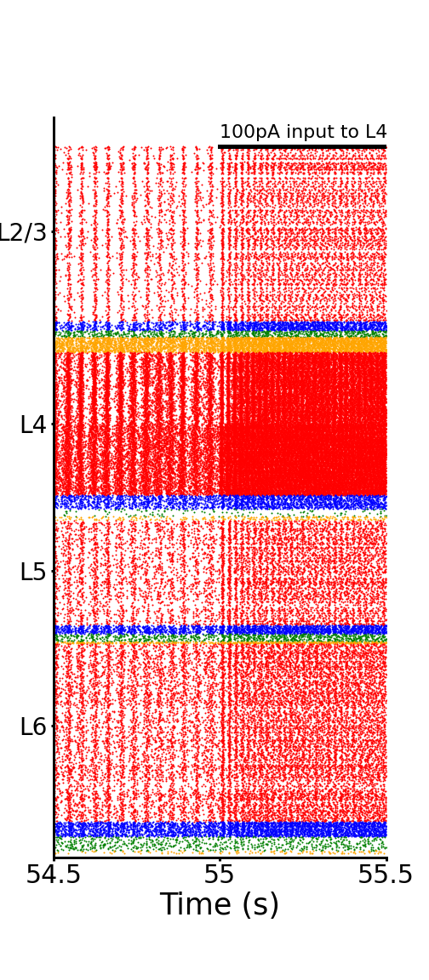

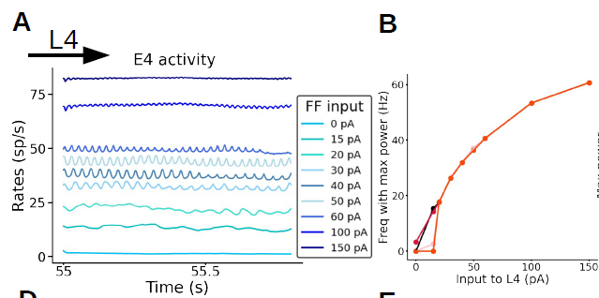
Effect of the FF input on oscillations
Frequency depends on the input f in [12 Hz – 60 Hz]
Notes:
9

Slide 10
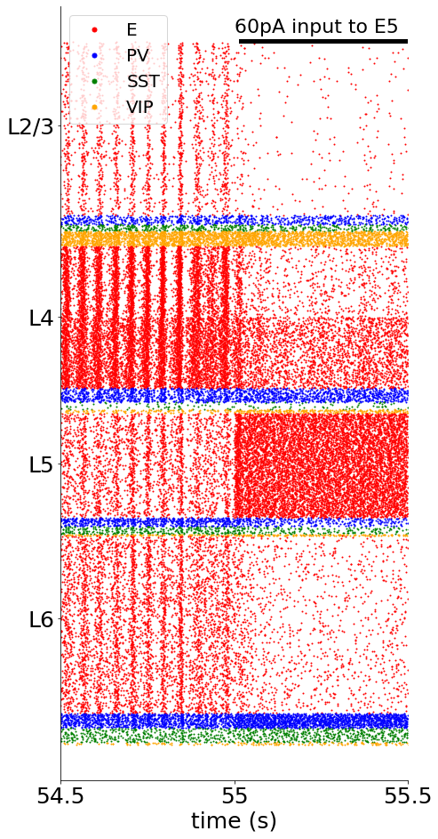
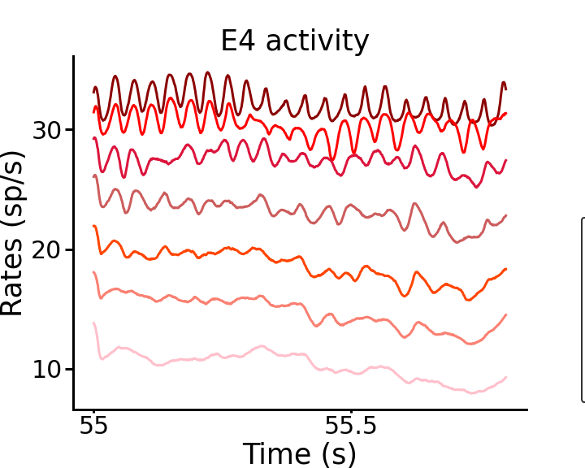
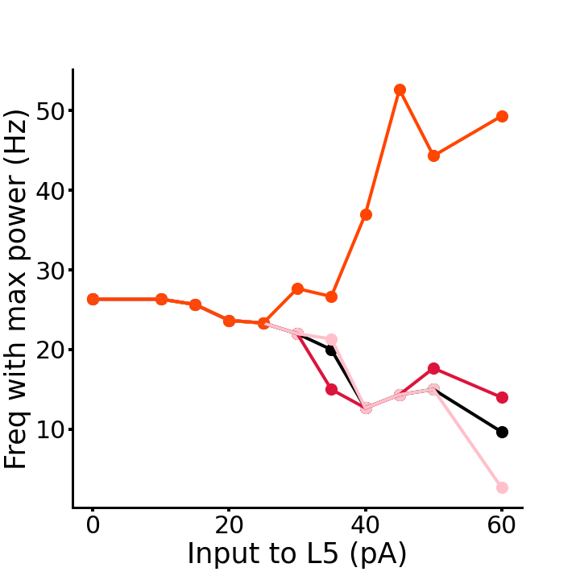
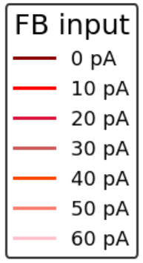
Effect of the FB input on oscillations
L5
F
L4
Notes:
10

Slide 11
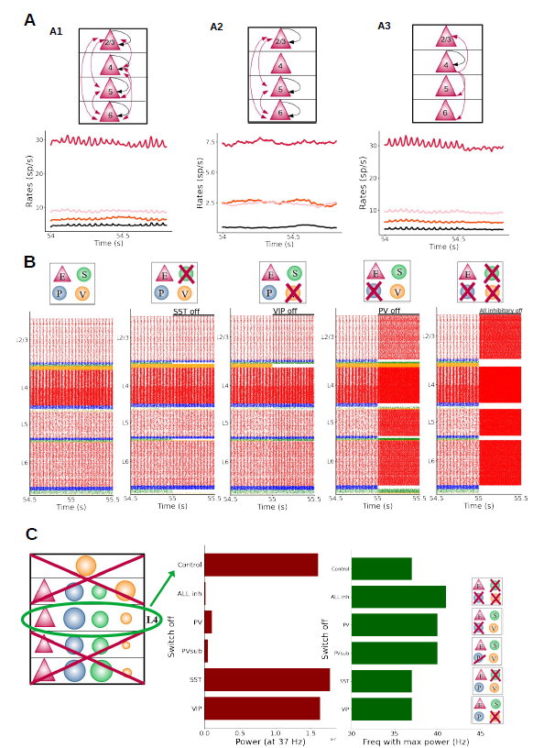
Manipulation on the model to study oscillations
Layers where plasticity is crucial to obtain oscillations.
Role of inhibitory neurons in oscillations
Plasticity outside L4 not crucial for oscillations
L4 crucial
All inhibitory groups contribute to oscillations
PV are the most important neurons

Slide 12
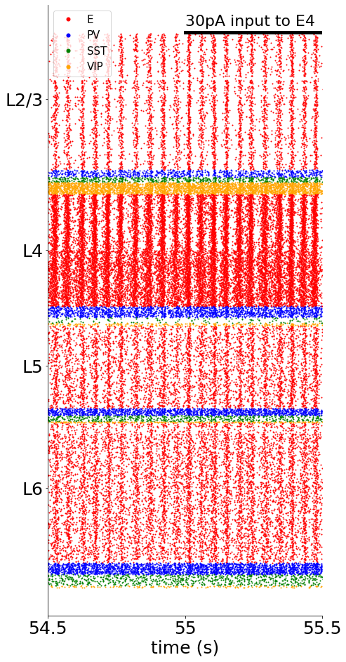
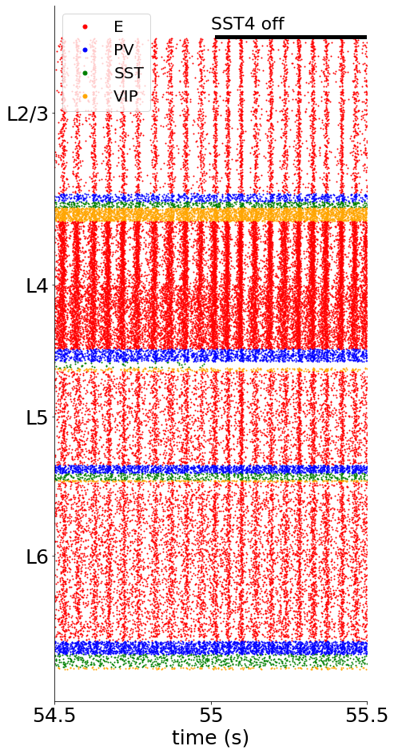
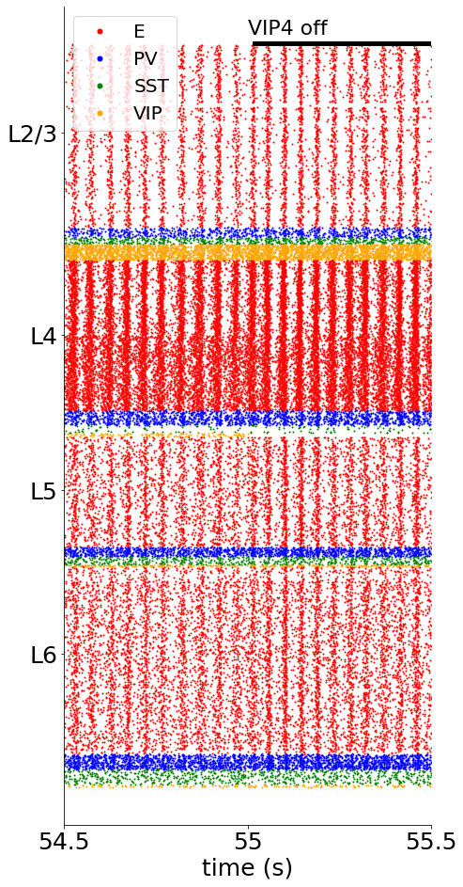
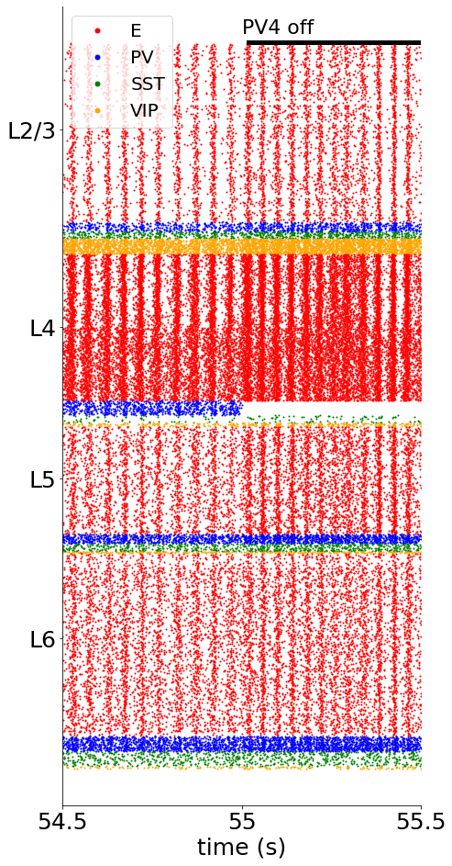
Effect inhibitory neurons on oscillations
Goal: Understand which are the most crucial groups involved in oscillations
“Optogenetics experiments” in the model:
Totally inhibit one group of neurons and see the effect on the oscillations.
PV4 off: bigger effect
compared to SST, VIP.
The speed of oscillations
is increased.
Removing one group
alone is not enough
to make huge changes
Notes:
12

Slide 13
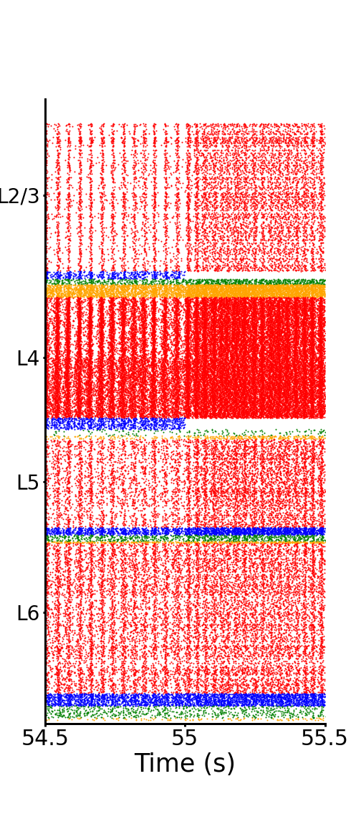
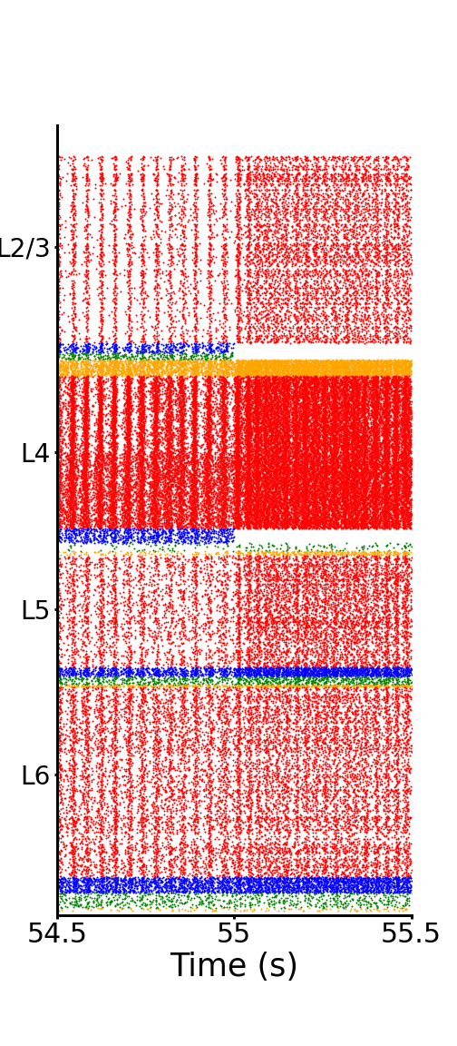
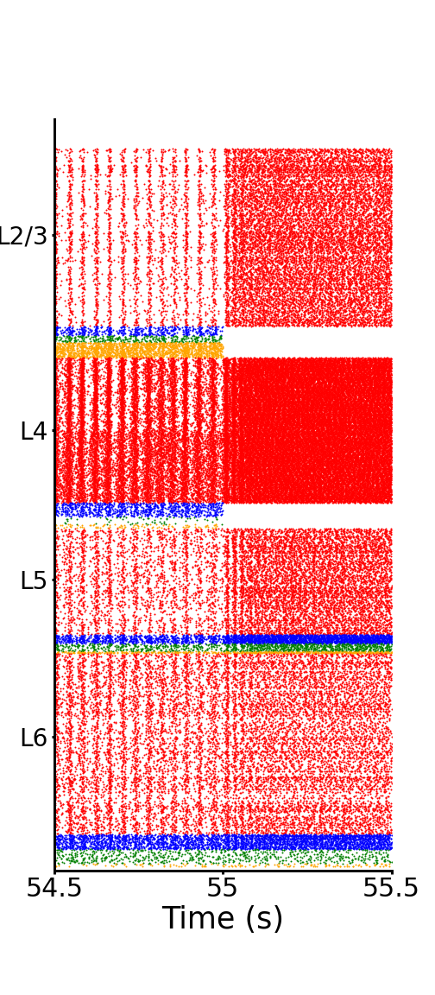
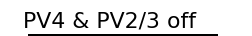
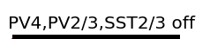
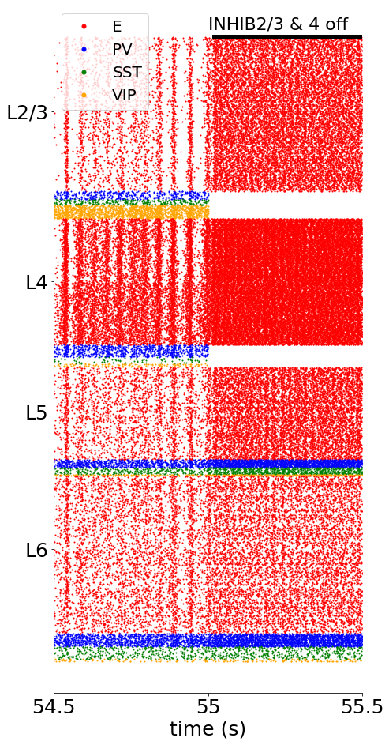
Effect inhibitory neurons on oscillations – different combinations groups off
Oscillations: it is an emerging property.
Each group on his own is not responsible alone but all together they are.
. . .
The more groups you inhibit the more the speed of the oscillations increase.
Each of them contributes to the oscillations
Notes:
13

Slide 14
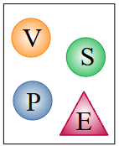
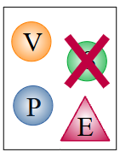
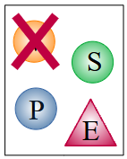
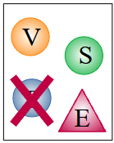
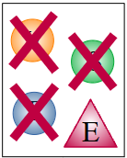
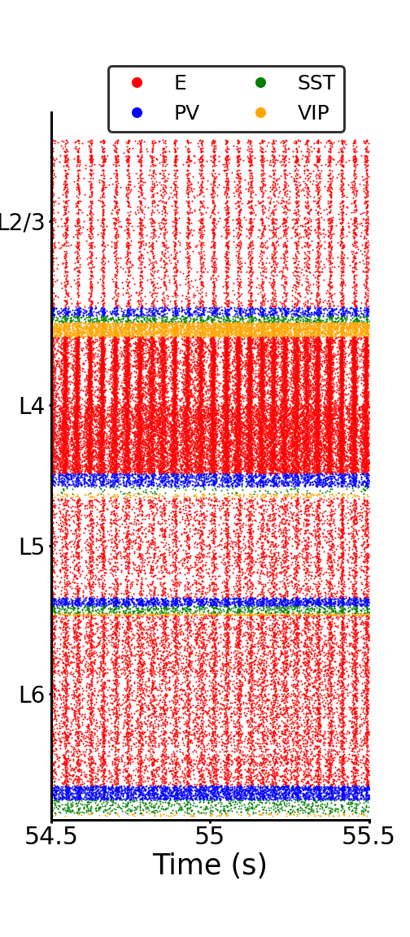
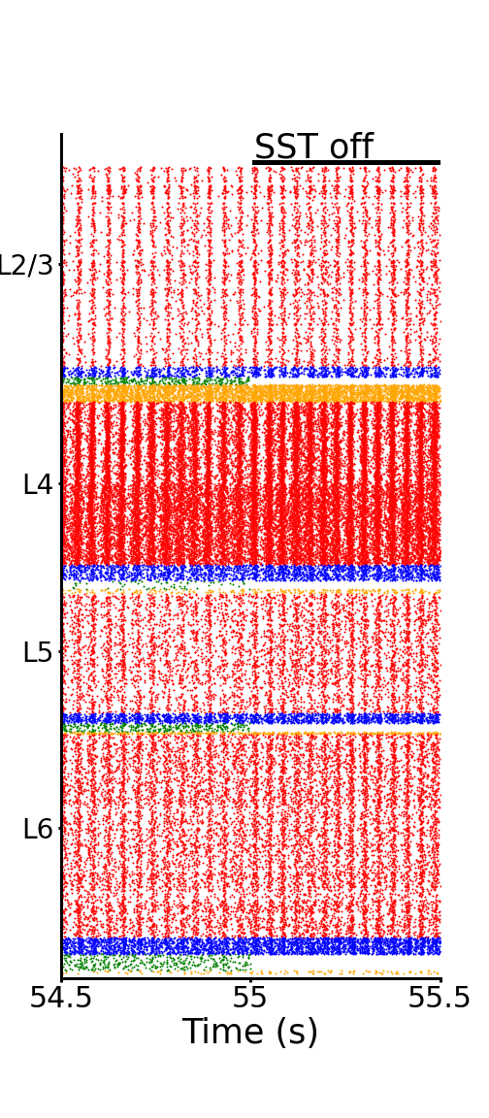
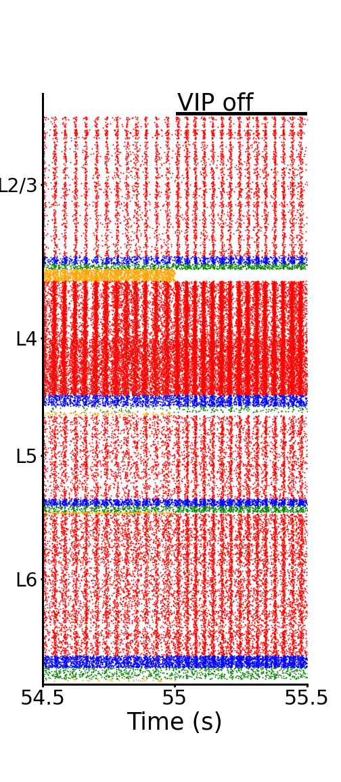
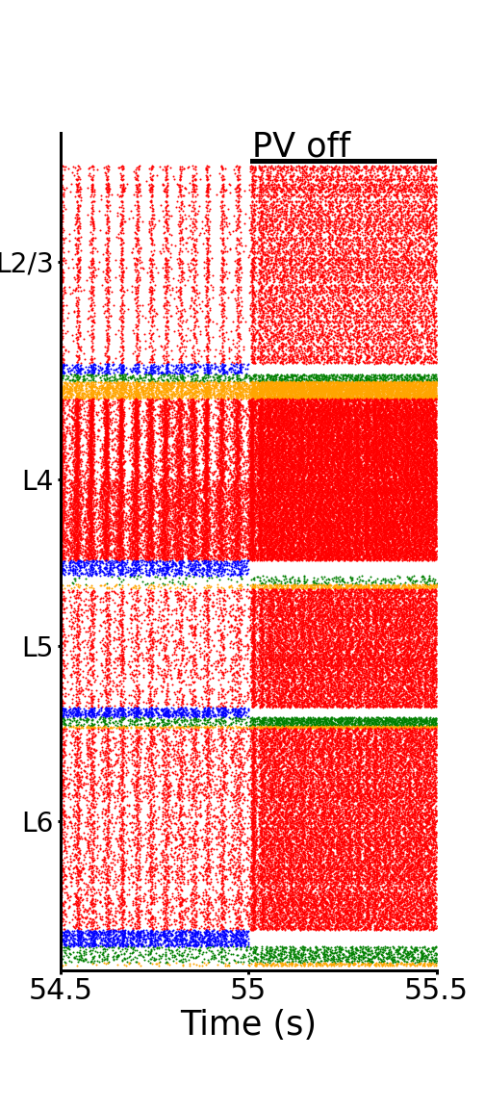

Effect inhibitory neurons on oscillations
PV are the most relevant group.
All groups contribute to oscillations
B
Notes:
14

Slide 15


Is the structure of learning crucial?
Fig. 8

Slide 16

Is the structure of learning crucial?
Notes:
16

Slide 17
Summary
Layer and cell-specific spontaneous activity matching experimental data
- Suppl.: effect of killing inhibition, scaling up
Layer and cell-specific evoked (FF input) activity matching experimental data
- Latency (L4→L23 → L5)
Feedback input & summary table of input effects to any cell type/layer.
Plasticity (STDP) in the model → emergence of oscillations
- Plasticity outside L4 not crucial for oscillations - L4 crucial
- Frequency depends on the input f in [12 Hz – 60 Hz]
- FB switches off oscillations
- Role of inhibitory groups on oscillations: PV most important group
- Structure of the learned weights is fundamental
Notes:
17

Slide 18
Cognitive and System Neuroscience group, SILS, University of Amsterdam
Acknowledgments
Jorge F. Mejias
Cyriel Pennartz
and everyone in the lab!
Notes:
18

Slide 19








Thanks for your attention!
Notes:
19

Slide 20
Back up slides

Slide 21





Is the structure of learning crucial?
Notes:
21

Slide 22


Layers where plasticity is crucial to obtain oscillations?
What happens with no self plasticity in L5, L2/3, L6? Oscillations still there?
Only plasticity within L4?
And no plasticity in L4?
Plasticity in E4 is crucial for oscillations
Notes:
22

Slide 23




Effect inhibitory neurons on oscillations - layer study
16 Hz
Increased speed of the oscillations
Layer 5
opposite
effect!
When interneurons are inhibited the speed of the oscillations increases.
They all play a role (each layer).
Notes:
23

Slide 24

Effect inhibitory neurons on oscillations
Switching off all inhibitory neurons →
activity too high, no oscillations visible anymore
Notes:
24

Slide 25
Effect inhibitory neurons on oscillations - Summary
Oscillations: it is an emerging property.
Each group on his own is not responsible alone but all together they are.
Without all the inhibitory I don’t have oscillations
but removing one group at a time (or few groups) still show oscillations.
Alone they are not crucial but all together they are.
Removing some inhibitory neurons → INCREASE the speed of the oscillations.
From 26 Hz to 37 Hz or even more! Depending on the groups I switch off.
They all contribute.
Which is the most crucial?
Notes:
25

Slide 26



Which group alone is able to mantain oscillations?
SST alone
VIP alone
PV alone
PV are crucial. Them alone are able to keep the oscillations at 25 Hz.
Notes:
26

Slide 27




1. LFP simulation
Best way to simulate LFP
Simulation of a neuropixel probe
Different angles of recording
Compare with experiments
Rares Dorcioman
7-month project

